Slide 1
Mushroom Classification
By: Ijeoma Akamnonu and Raizel Bernstein

Slide 2
Business Problem
Restaurants rely on only edible mushrooms
Poisonous mushrooms are a liability that could cost the business millions if not carefully weeded out
Customers could face adverse side effects
Possibility of getting sued
A single slip up could lead to an ill customer or even a death.
This situation must be avoided

Slide 3
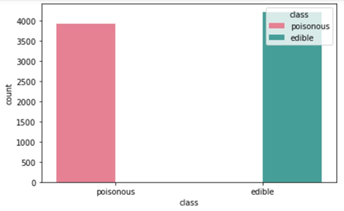
Data
data from Kaggle.com
23 columns and 8124 rows
No class imbalences
light cleaning (no missing values)
Labeled for easier observations
Label encoded for modelling

Slide 4
Methods
We used 3 models in total to create our predictions.
Random Forest
categorical
Decision Tree
categorical
Logistic Regression
Logged odds coefficients
Features based on data and domain knowledge

Slide 5
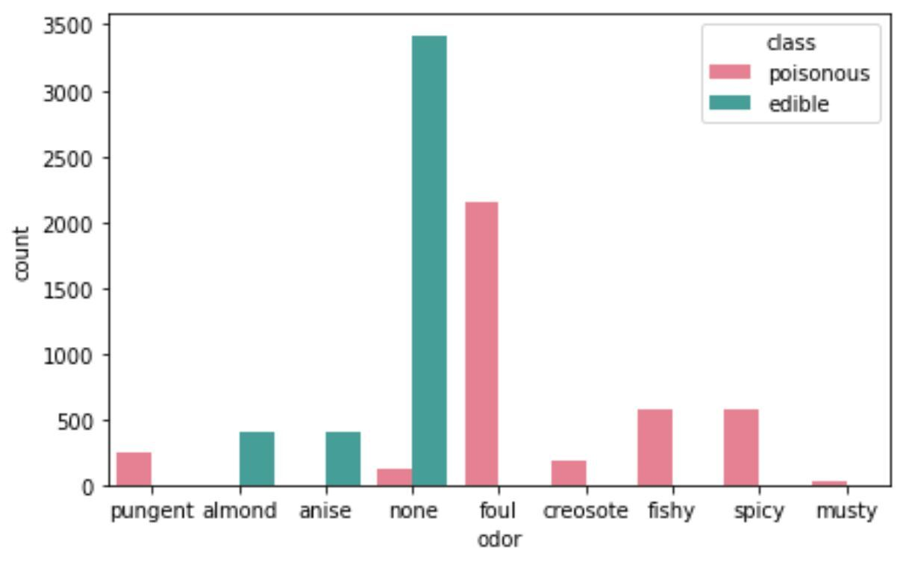
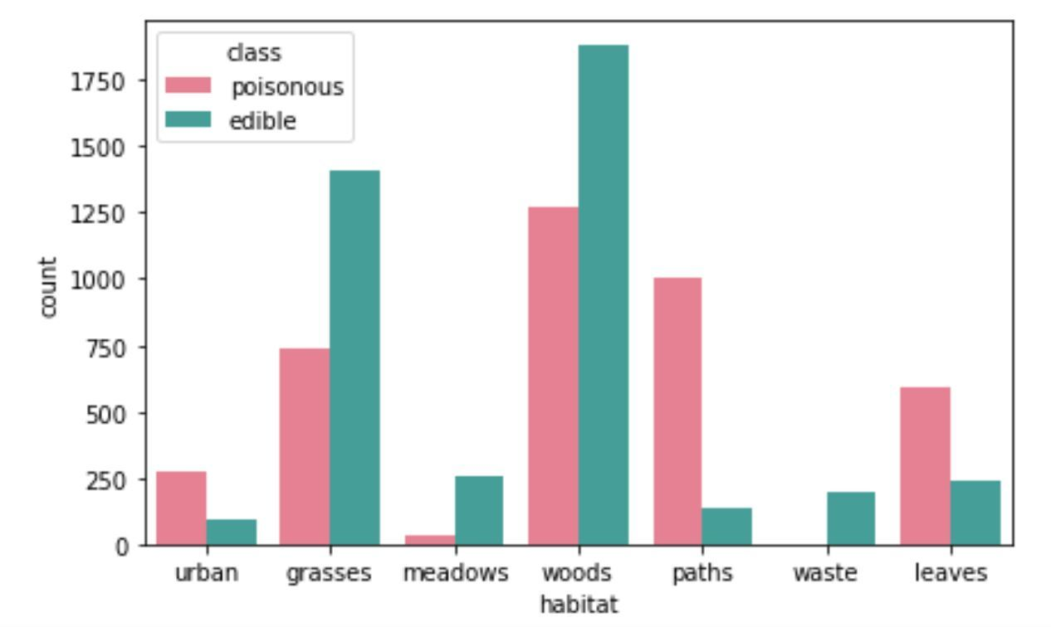
Based on EDA
odor: Interestingly, things that we would typically consider "good" smells are for mainly for edible mushrooms. All other less pleasant smelling mushrooms are indications of a poisonous species.
Habitat: From the habitat graph one can see that waste has edible mushrooms. Wood and grass areas are more likely to have edible mushrooms, but a lot of mushrooms found in the woody and grassy areas are poisonous. Paths are likely to have poisonous mushrooms.

Slide 6
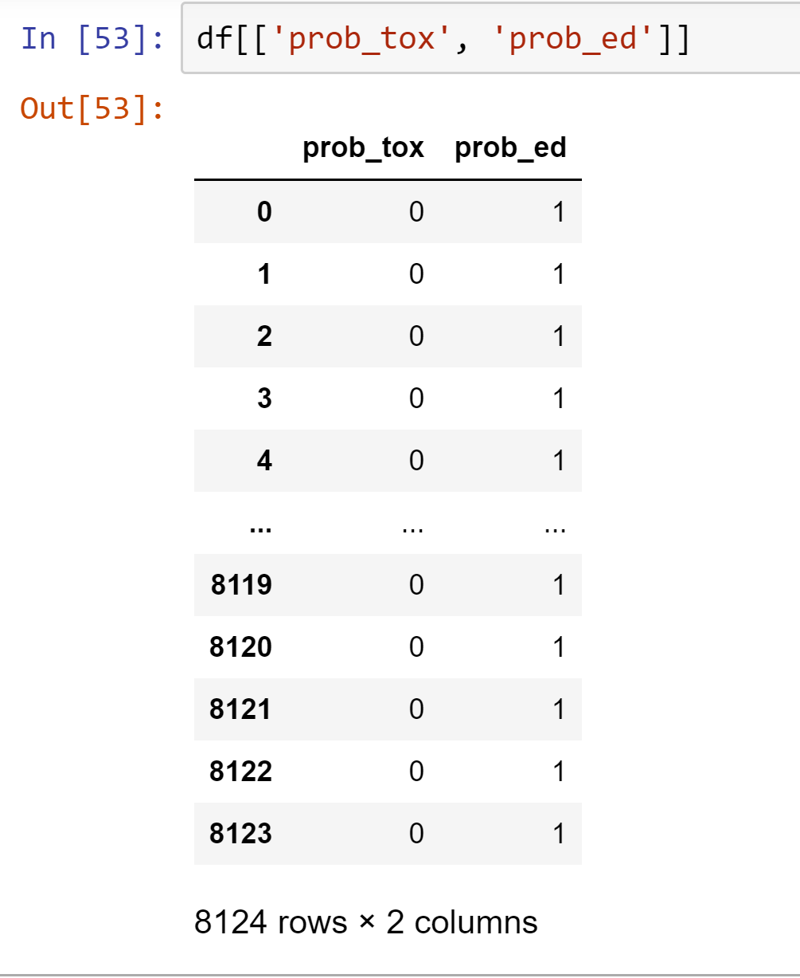
Based on Domain
Information from several websites helped compile 2 features based on common toxic and edible characteristics of mushrooms.
Prob_tox: toxic mushrooms usually have red caps, white spores, etc.
Prob_ed: non-toxic mushrooms usually have tan and brown gill colors, etc

Slide 7
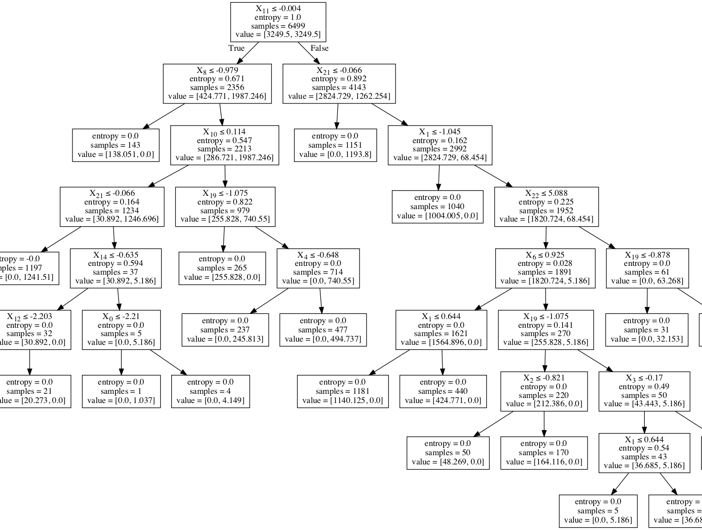
Results
Giving us an accuracy score of 100%, Decision Tree was the best model.
Our 4 best features were gill-size, habitat, probably_edible, and green colored spore prints

Slide 8
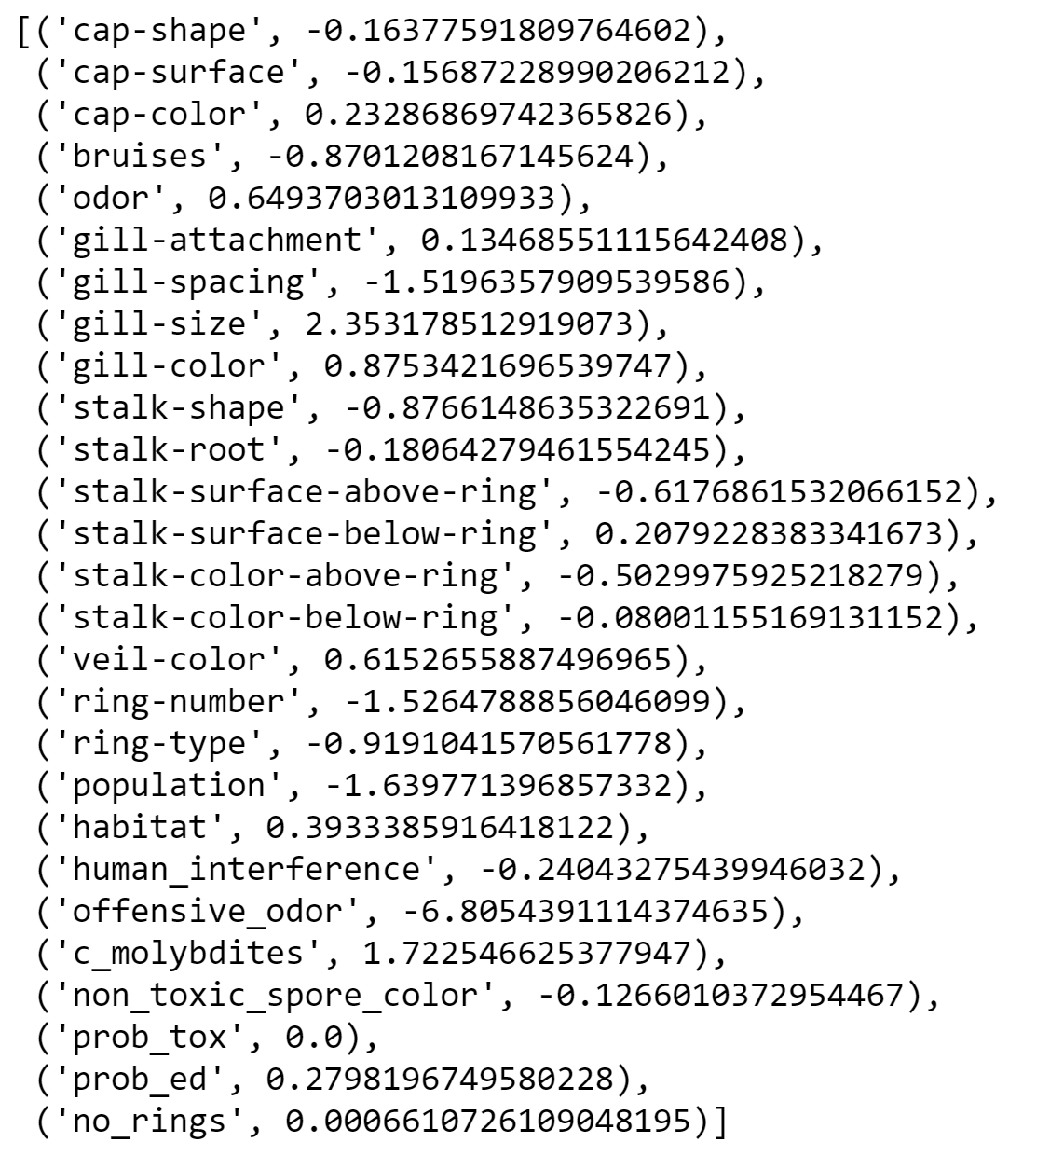
Conclusions and Insights
Spore print color plays a major role in the predictability of the model.
Decision tree was considered the best model because unlike random forest, it did not include our most predictive features.

Slide 9
Next Steps
Get more data to ensure all bases have been covered. We cannot risk ingesting a single toxic mushroom.

